Slide 1


DATAVERSE - DATA
DATA CHALLENGE 2022-2023
Presented by:
EL-FAILALI-LBALGHITI MOHAMED
ELQAJJAM MOHAMED
ENSA MARRAKECH

Slide 2
Table of contents
01
02
03
objective
Methodologie
Conclusion

Slide 3

OBJECTIVE
Introduction:
As part of the Dataverse event, the Dataverse committee offers us a Data challenge, which aims to explore machine learning methods for classifying whether a patient is smallpox positive or not.
Goals:
Apply machine learning methods to Classify whether the patient is smallpox positive or not.

Slide 4
METHODOLOGIE
In this project we used Machine Learning Framework or libraries, as long as to provide the final CSV output file with your model predictions.
Scikit-Learn, Matplotlib, Seaborn, Numpy, Pandas ...
Upload the csv file
Apply machine learning methods to Classify whether the patient is smallpox positive or not.

Slide 5
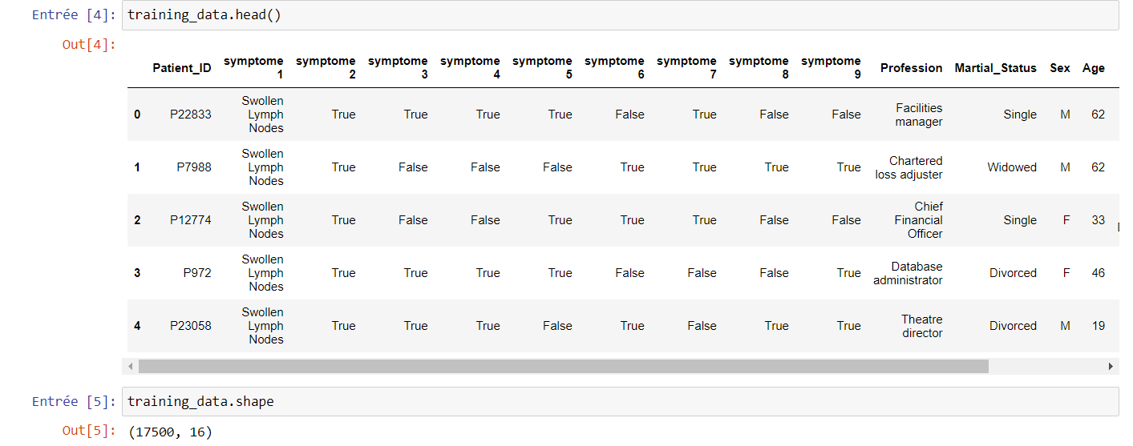
METHODOLOGIE

Slide 6
METHODOLOGIE
Clean Data, Pre-processing, Feature Engineering
after upload the csv dataset; we prepared the data:
Drop NAN values
Drop id columns
Explore data
Dividing features into Discrete and Categorical :
Label Encoder Transformation
(Transform categorical columns to dummies variables)
Check imbalanced Datasets (umbalanced)
Visualisation

Slide 7
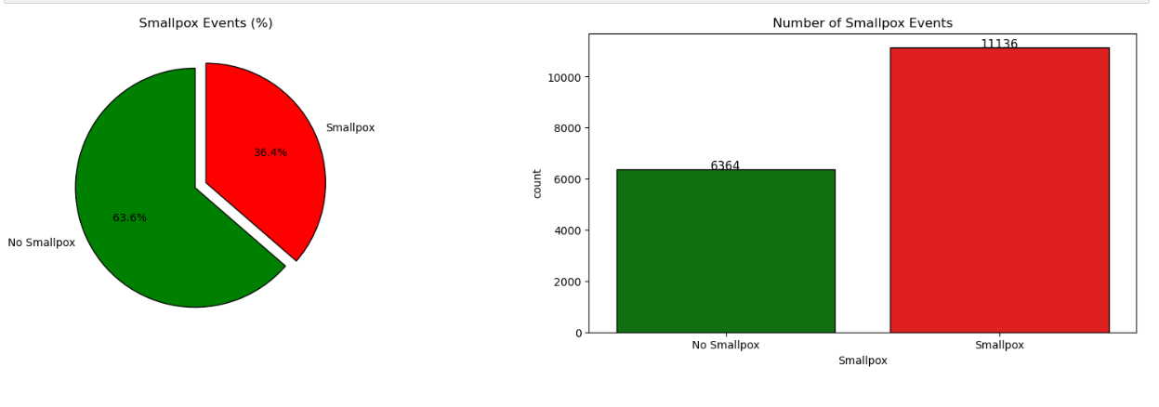
METHODOLOGIE
Check imbalanced data
Oversampling to balance our data

Slide 8
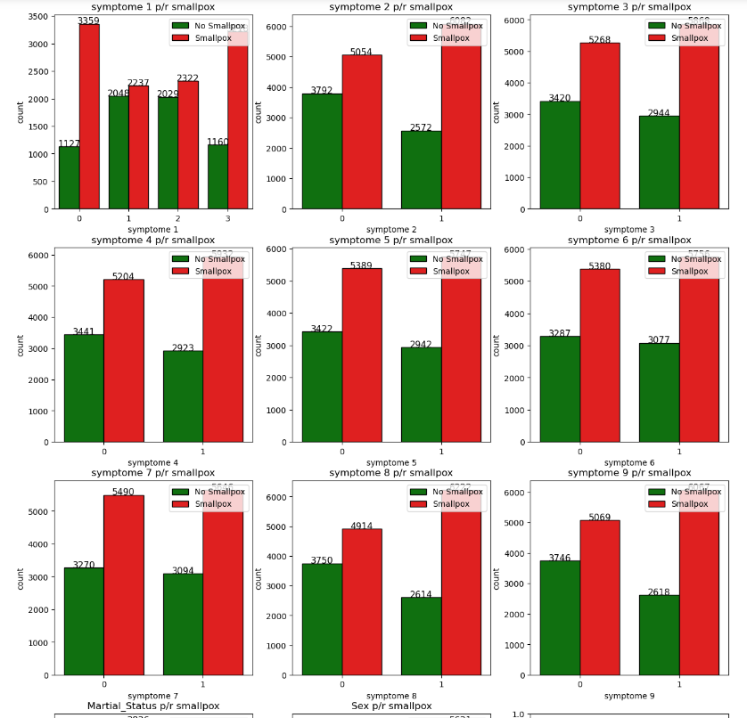
METHODOLOGIE
Categorical features / target
all the graphes shown the same pattern.

Slide 9
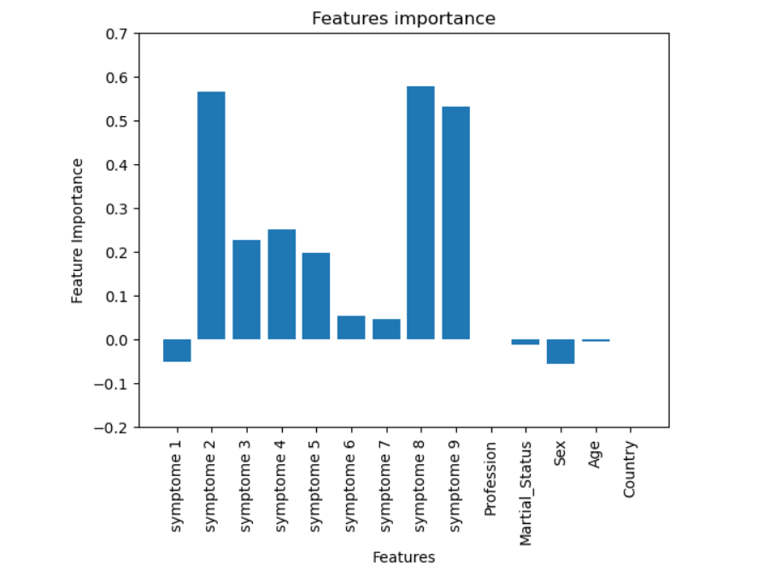
METHODOLOGIE
Features importance

Slide 10
METHODOLOGIE
Create the model
Split train, test :
Selecting the features from training data and splitting the data into 85 - 15 train - test groups.
Training the model using algorithms of classification; like Xgboost, random forest, logistic regression.
We find that the logistic regression give us the best score.
classifier.fit()
classifier.predict()
After fitting, we used the result to predect the Smallpox values for the validation data, and export the csv file to the trustlii.io platform for validation.

Slide 11
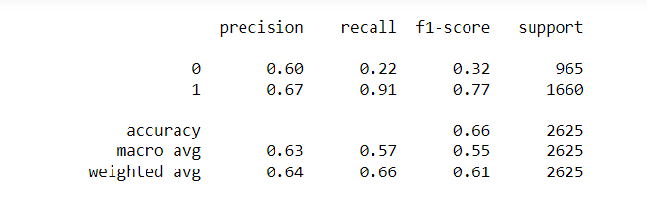
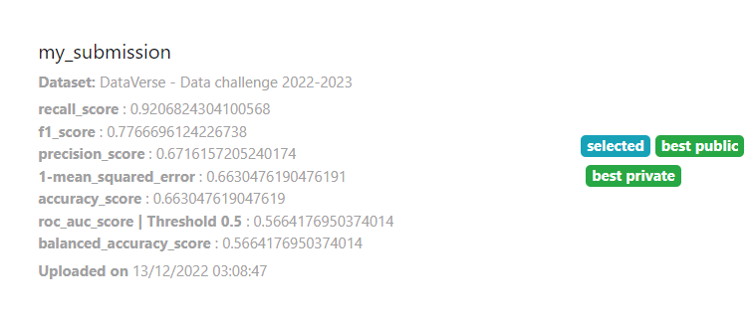
CONCLUSION
Classification-report():

Slide 12

WE WANT TO SAY
THANK YOU
FOR YOUR ATTENTION,
FOR YOUR ORGANISATION

